Slide 1
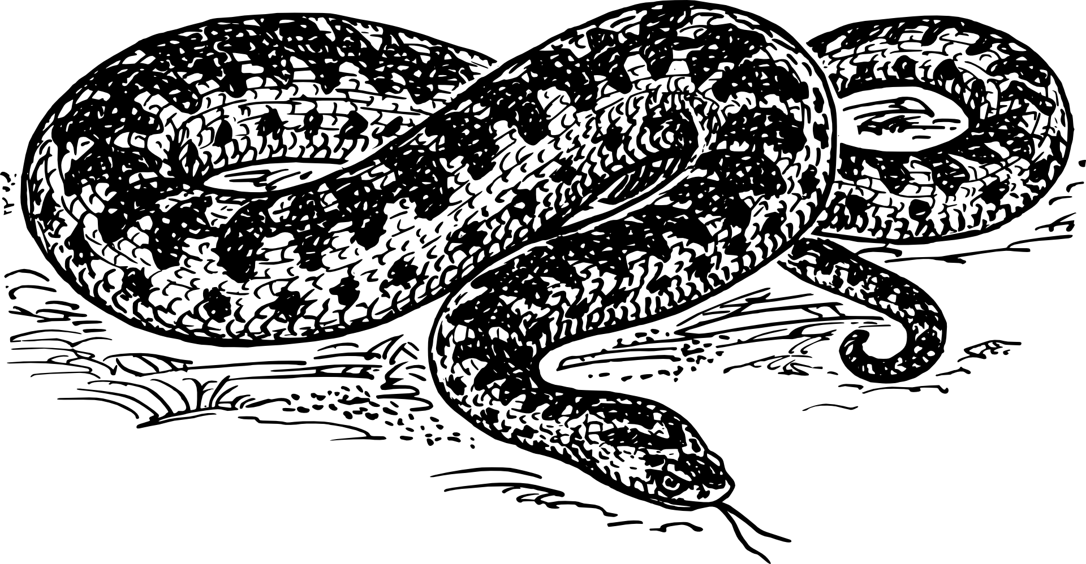
Python Day Intermediate Workshop
WiFi Network: Guest | No Password
Please open https://repl.it and http://bit.ly/scpdi

Slide 2
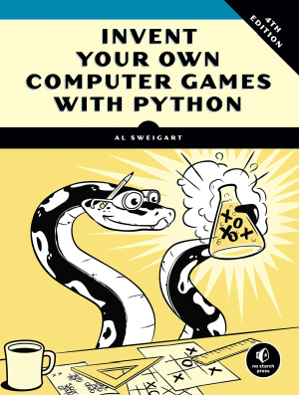
Python Day – Intermediate Workshop
Based on “Invent Your Own Computer Games with Python” – Chapter 13
Get the full book (or read it free online) at https://inventwithpython.com/invent4thed

Slide 3


Slide 4
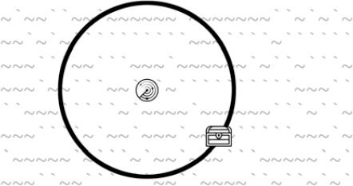
The Treasure Hunt

Slide 5
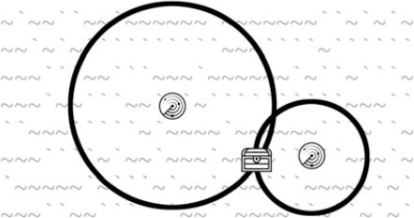
The Treasure Hunt

Slide 6
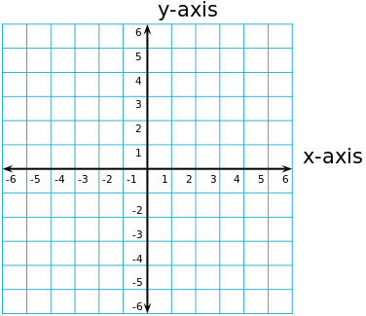
Concept: Cartesian Coordinates

Slide 7
Concept: Cartesian Coordinates

Slide 8
Concept: Lists
In Python a list is a variable that can hold
multiple other variables... including other lists.
x = [] # empty list
y = [ "potato" , 78 , "hut" , "hike" ]
z = [ [ 1 , 2 ] , ["apple" , "orange"] ]
Lists start counting at 0
y[0]’s value is “potato”
z[1][0]’s value is “apple”

Slide 9
# Sonar Treasure Hunt
import random
import sys
import math
def getNewBoard():
# Create a new 60x15 board data structure.
board = []
for x in range(60): # The main list is a list of 60 lists.
board.append([])
for y in range(15):
# Each list in the main list has 15 single-character strings.
# Use different characters for the ocean to make it more readable.
if random.randint(0, 1) == 0:
board[x].append('~')
else:
board[x].append('`')
return board
# try a line that shows the list we just created

Slide 10

The Raw Ocean
print(getNewBoard())

Slide 11
def drawBoard(board):
# Draw the board data structure.
tensDigitsLine = ' ' # Initial space for the numbers down the left side of the board
for i in range(1, 6):
tensDigitsLine += (' ' * 9) + str(i)
# Print the numbers across the top of the board.
print(tensDigitsLine)
print(' ' + ('0123456789' * 6))
print()
# Print each of the 15 rows.
for row in range(15):
# Single-digit numbers need to be padded with an extra space.
if row < 10:
extraSpace = ' '
else:
extraSpace = ''
# Create the string for this row on the board.
boardRow = ''
for column in range(60):
boardRow += board[column][row]
print('%s%s %s %s' % (extraSpace, row, boardRow, row))
# Print the numbers across the bottom of the board.
print()
print(' ' + ('0123456789' * 6))
print(tensDigitsLine)
# How could you print the game board?

Slide 12
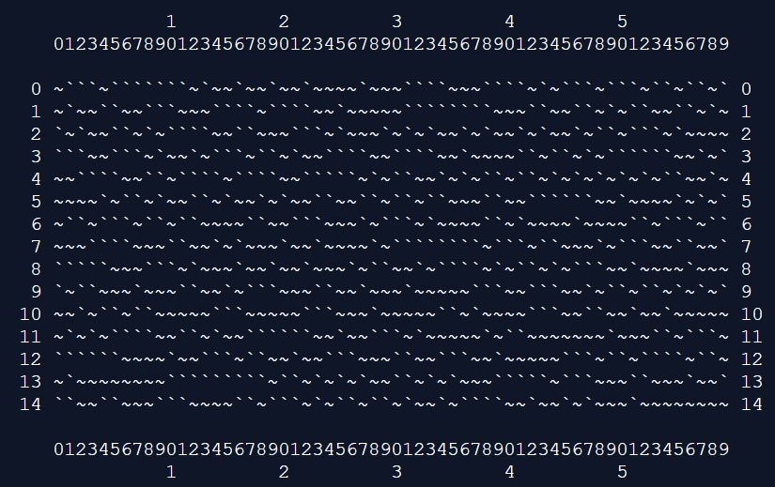
The Formatted Ocean
board = getNewBoard()
print(drawBoard(board))

Slide 13
def getRandomChests(numChests):
# Create a list of chest data structures
# (two-item lists of x, y int coordinates).
chests = []
while len(chests) < numChests:
newChest = [random.randint(0, 59), random.randint(0, 14)]
if newChest not in chests:
# Make sure a chest is not already here.
chests.append(newChest)
return chests

Slide 14
Show the Chests
print(getRandomChests(3))

Slide 15

Show the Chests
print(getRandomChests(3))

Slide 16
Concept: Pythagorean Theorem
A² + B² = C²
4² + 3² = C²
B
16 + 9 = 25
4² + 3² = 5²
A
C

